Slide 1

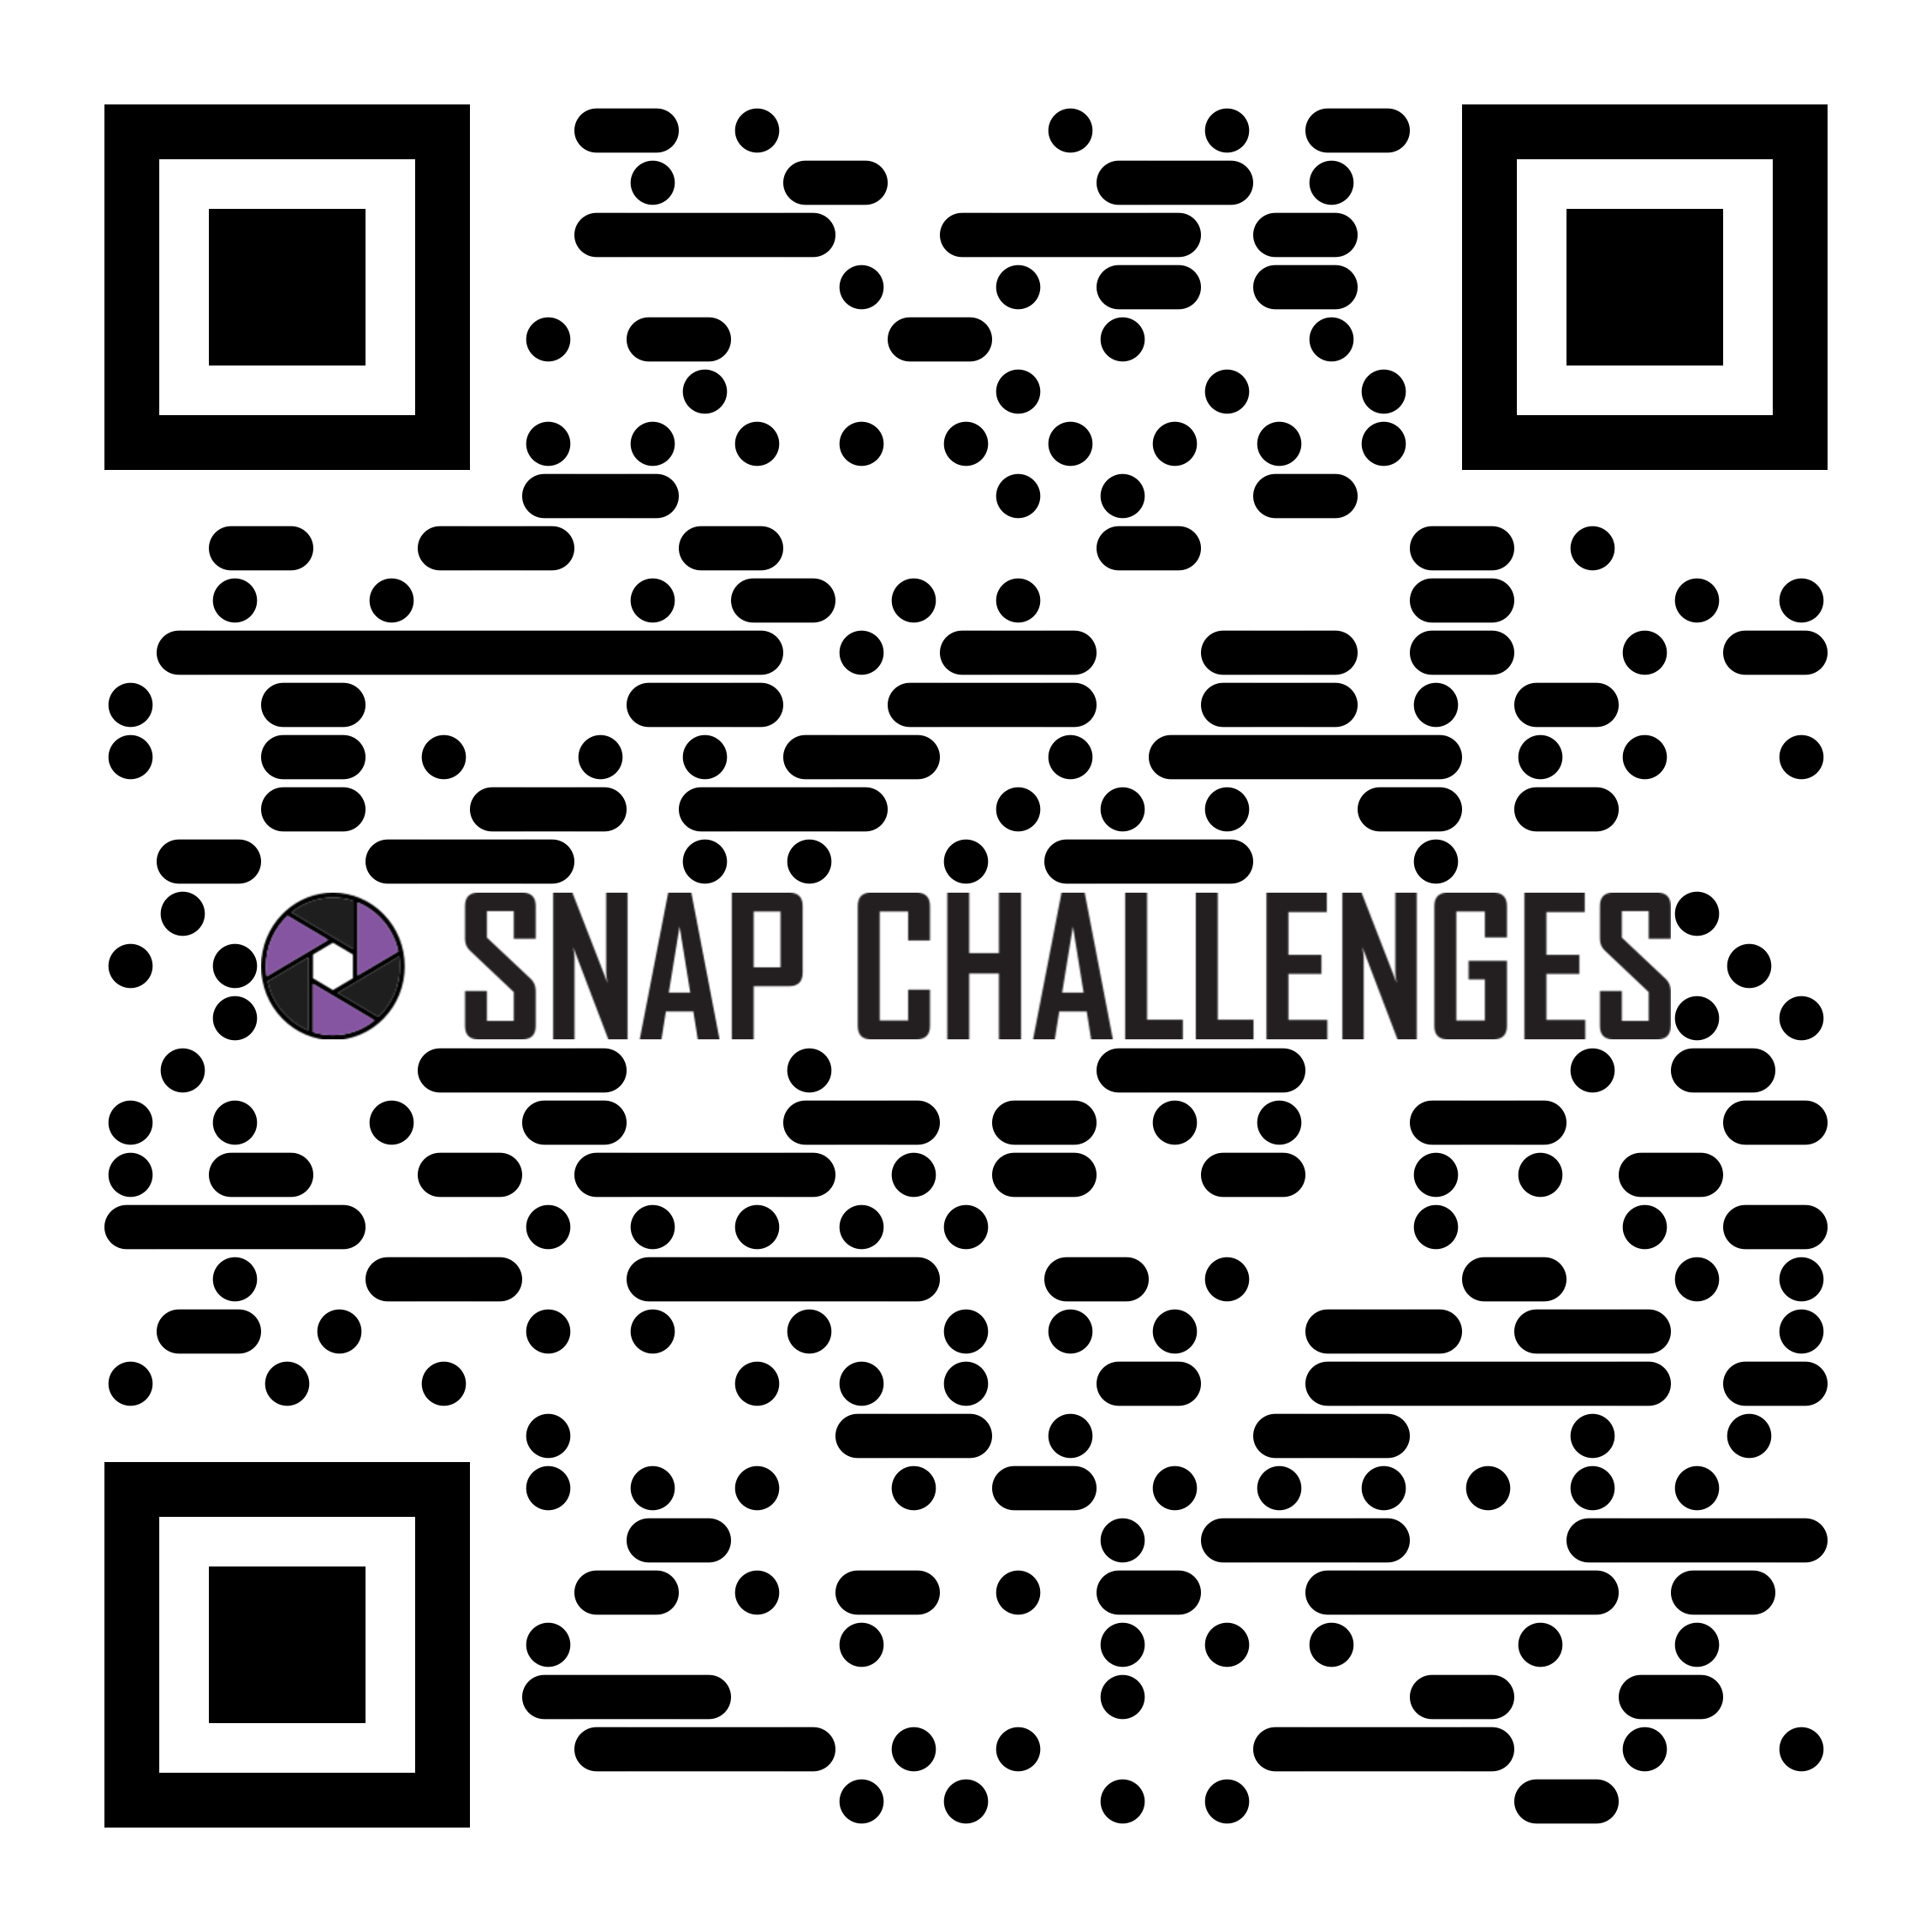

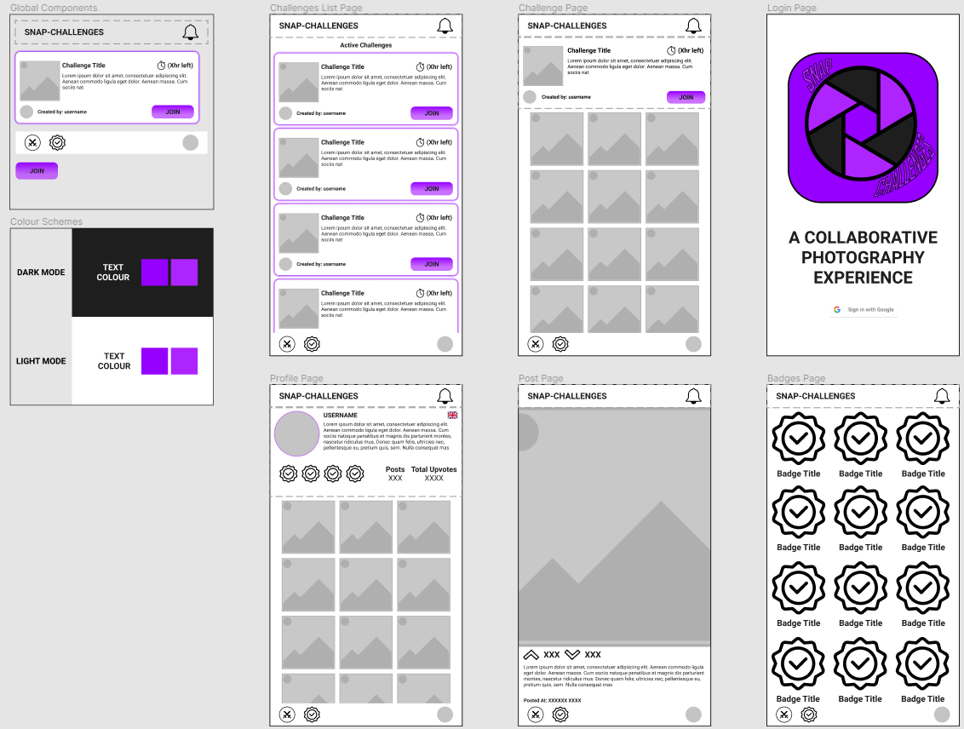
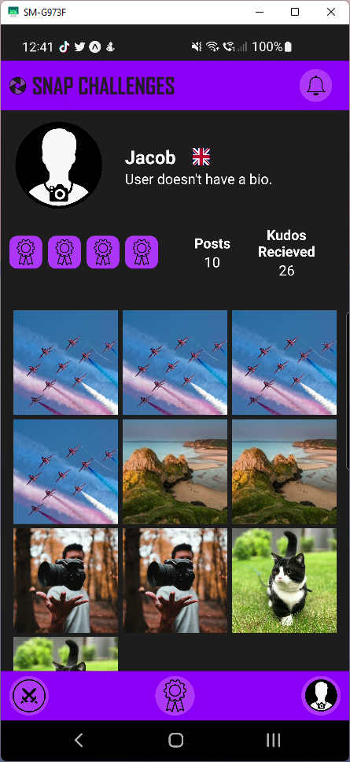
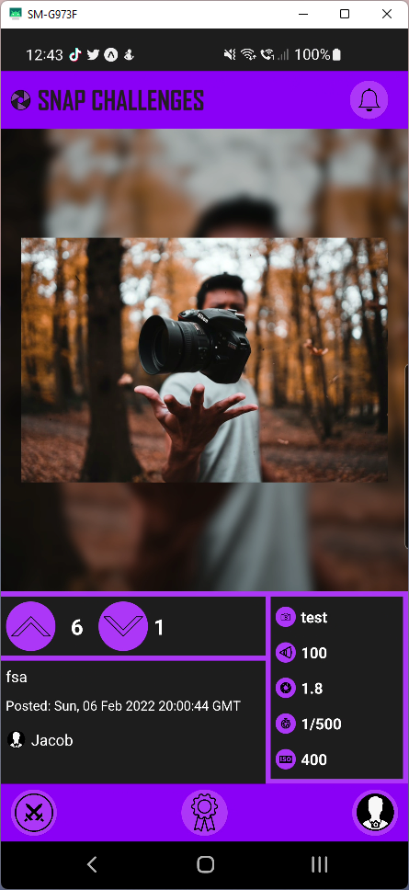
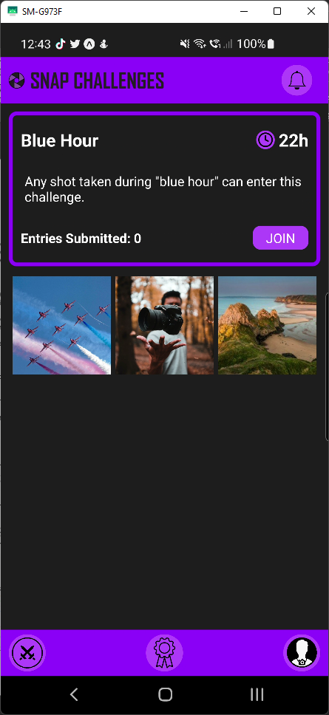
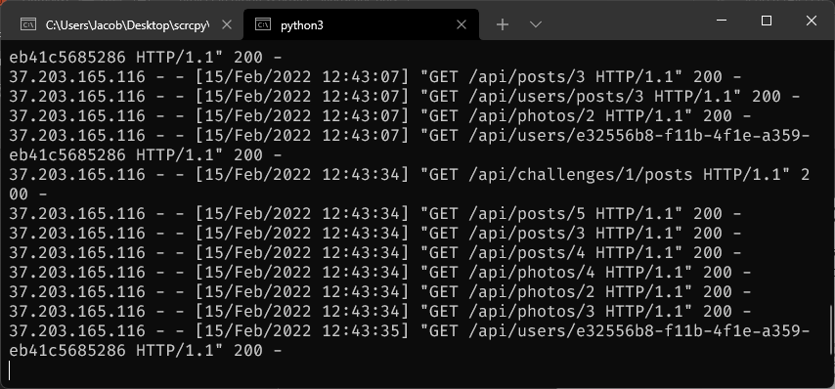
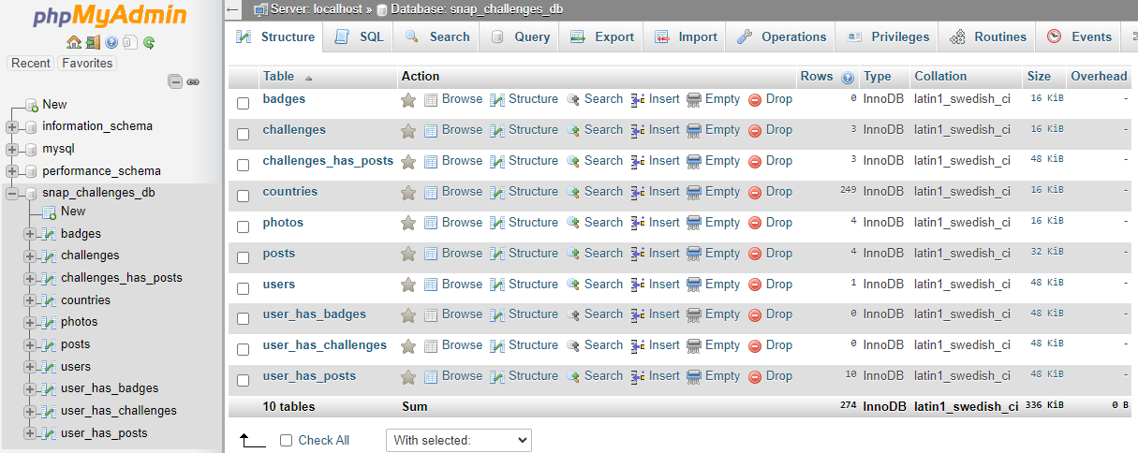
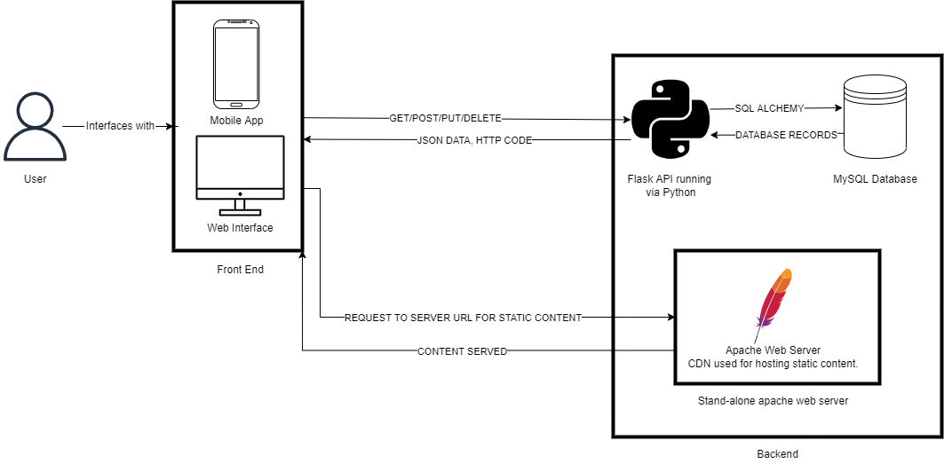
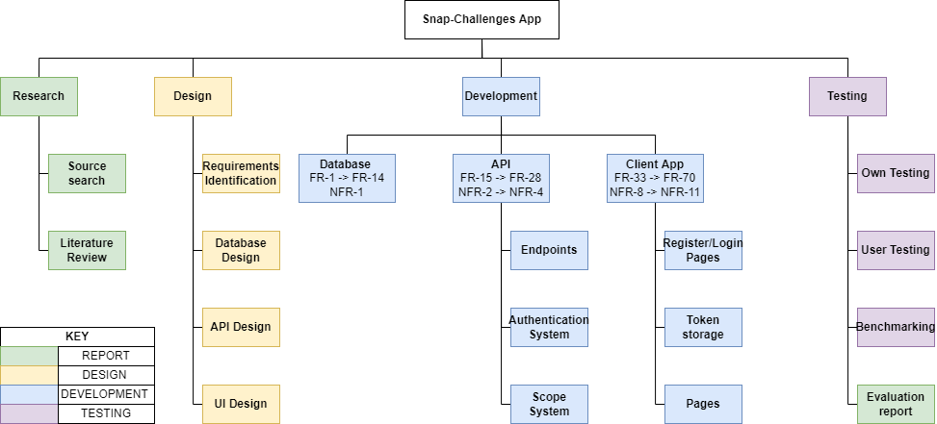
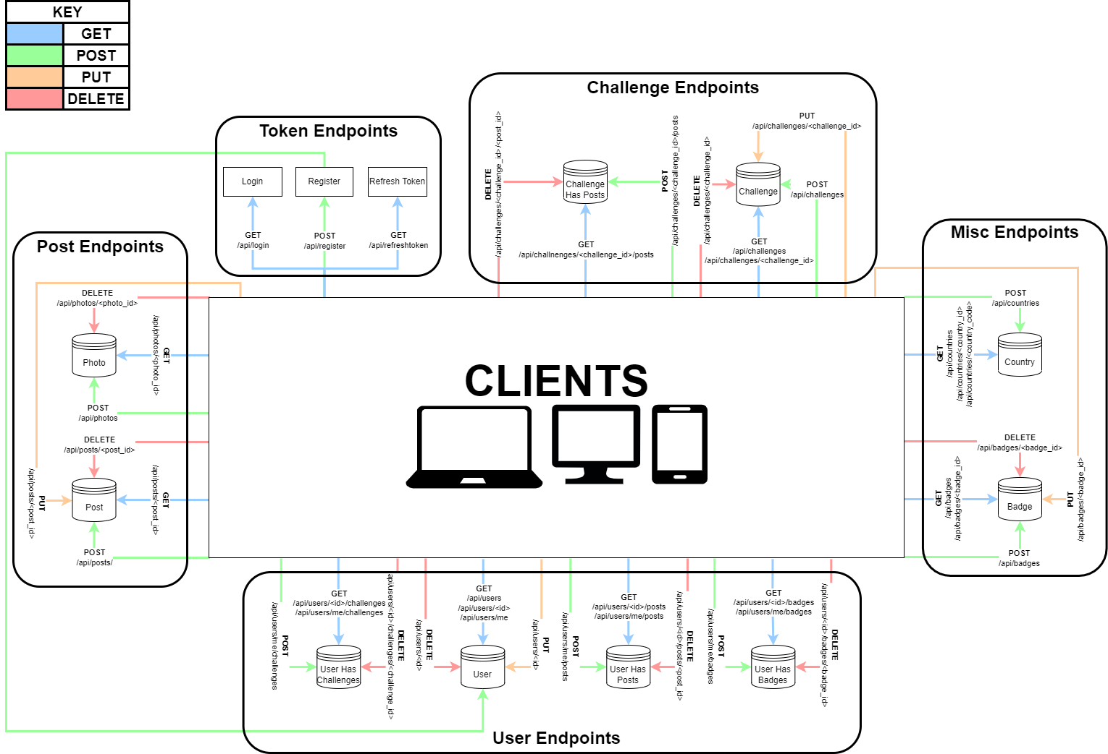
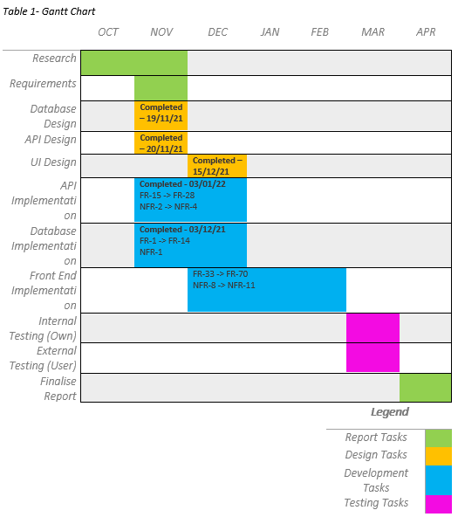
Research: Gamification: (Hamari and Huotari, 2012) Define gamification as “a process of enhancing a service with affordances for gameful experiences in order to support user’s overall value creation.” There are many gamification approaches however, the best are challenges, achievements and leader boards. This a result of dopamine hit granted by them. Dopamine is “well known for their strong responses to rewards and their critical role in positive motivation.” (Bromberg-Martin, 2010) HTTP Protocol: A CRUD style API will require use of GET/POST/PUT and DELETE requests. GET – used for retrieving data from the API. POST – used for sending new data to the API. PUT – used for updating db records via the API. DELETE – used for deleting records stored on the db via the API. Database: An SQL database best fits the needs of this project, the data is well structured so easily fits into a traditional relational table. This could be backed up with a redis cache if demand requires it. “Redis is an in-memory remote database that offers high performance, replication, and a unique data model to produce a platform for solving problems.” (Carlson, 2013).
UFCFXK-30-3: Digital Systems Project
Student name: Jacob Allen
Project Title: Snap-Challenges Photography Gamified App
React native vs PWAs
React native will be the chosen cross-platform tool due its native level integration “React Native renders using its host platform’s standard rendering APIs” (Eisenman, 2017). This gives us great integration and access to device features such as the camera and notifications.
Top 5 Functional & Non-functional requirements:
Functional
An upload system must allow images to be uploaded to the CDN.
A login API endpoint which must return a JWT key which will allow access to the rest of the API if the login is valid.
A register API endpoint which must create a new user in the database ensuring security by hashing and salting the password given.
Camera settings must be shown on the post page.
Images shown on the post page must maintain their original aspect ratio to ensure they are displayed as the photographer intended.
Non-functional
Any API request should respond in an average time of 3 seconds.
The API must be accessible from an external network.
The CDN must be accessible from an external network.
Pages must load within an average of 3 seconds on a 4g throttled connection.
Camera info such as focal length must be clearly visible on the post page if it is available.
Abstract:
This project is focussed on developing a cross platform app, using react native, the app will utilise gamification techniques to such as challenges to engage photographers with their craft. There will also be a slight educational focus as camera info and settings will also be shown if available from the images meta data or specified by the user.
Initial figma UI designs
Aims and objectives:
AIMS:
To develop a platform independent app to gamify photography via the use of challenges.
To minimise burn out amongst photographers using these challenges to engage them with the app and their hobby.
To educate the users of the app by providing information about the camera settings used to achieve the resulting photo.
OBJECTIVES:
Research gamification benefits and drawbacks, and other times it has been used in the photography field.
Research React Native in comparison to Progressive Web Apps (PWAs).
Research data storage solutions MYSQL vs NOSQL.
Design and develop the database schema.
Design and develop the Python Flask API.
Design and develop the front-end client with React Native.
Test the system from both a technical and user perspective.
Produce a report to summarise findings, research, implementation, and testing stages of development.
Implementation artefacts
API running on a VPS
Design & Implementation
Database as seen in
phpMyAdmin
Project architecture
diagram
The profile, post and challenges page.
Planning and Management:
API design diagram
REFERENCES:
Hamari, J., Huotari, K. (2012) 16th International Academic Mindtrek Conference [online], Tampere, Finland, 3-5 October 2012. Association for Computing Machinery. Available From: https://dl-acm-org.ezproxy.uwe.ac.uk/doi/10.1145/2393132.2393137 [Accessed 05 January 2022]
Bromberg-Martin, E., S., et al (2010) Dopamine in Motivational Control: Rewarding, Aversive, and Alerting. Neuron [online]. 68(5), pp.815-834. [Accessed 16 January 2022]
Carlson, J. (2013) Redis in Action [online] New York: Manning Publications Co. [Accessed 28 December 2021]
Eisenman, B. (2017) Learning React Native [online] 2nd Edition. California: O’reilly Media, Inc. [Accessed 21 January 2022]

